Slide 1
Expedia Hotel Recommendation System
by
Basava Kanaparthi Sreepradhana Thirumalaiswami
Sindhuja Kancharla Subathra Vijayakumar

Slide 2
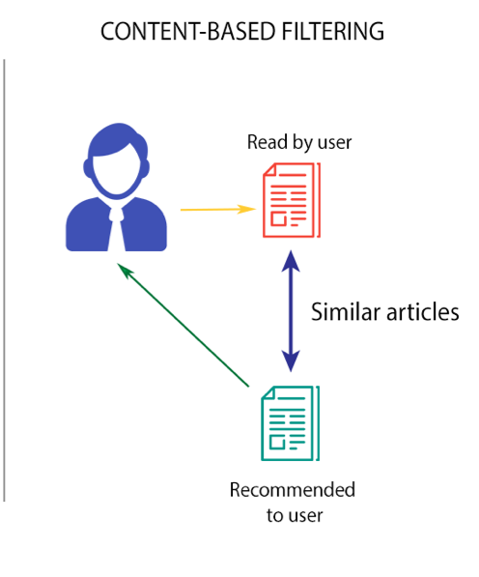
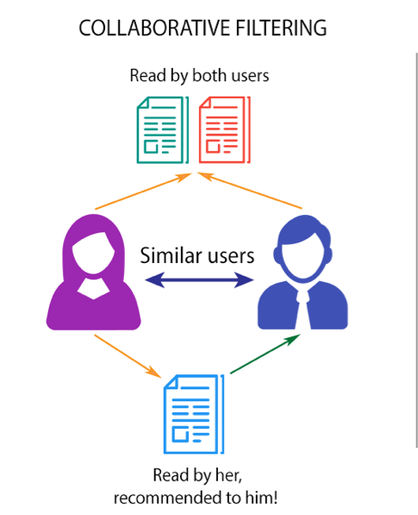
Two faces in the recommendation system:
Content Based
Collaborative Filtering
Accurate for users with history
Good for new users
Presenting the top results
Merging the best from the two approaches

Slide 3
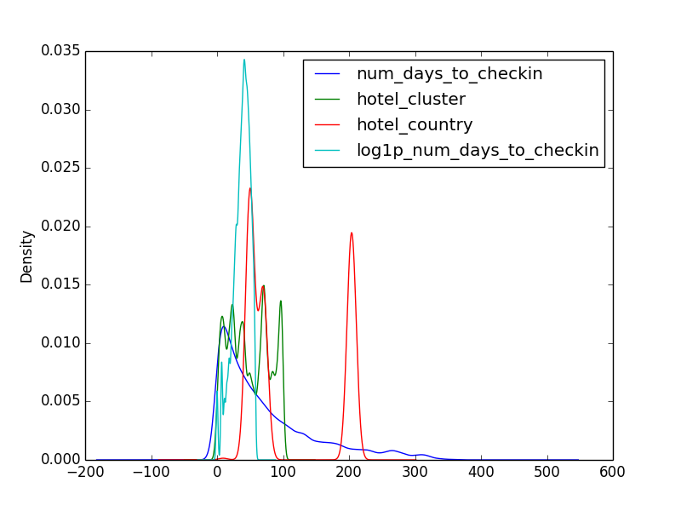
Distribution of different attributes
Most of the attributes follow Gaussian distribution
Preprocessing

Slide 4
Content Based Filtering

Slide 5
Collaborative filtering
K- Nearest Neighbors:
Approach:
O/p: The top 50 similar users
Matrix Factorization:
I/P: K-nearest neighbors to the target user
Filtering: only similar users who have travelled to the target user’s destination
The top 10 filtered users are passed onto matrix factorization

Slide 6
Extended Matrix Factorization
Gradient descent – to find the local minimum of deviation of predicted form actual value
Fills in missing values
Beta factor- for regualrization

Slide 7
Merging results from the two approaches
Content based predicts better – most users have good history and repeated travels
Collaborative- relatively lower accuracy
Merging – more weightage for content based
Final output of prediction – top 5 predictions for the target user

Slide 8
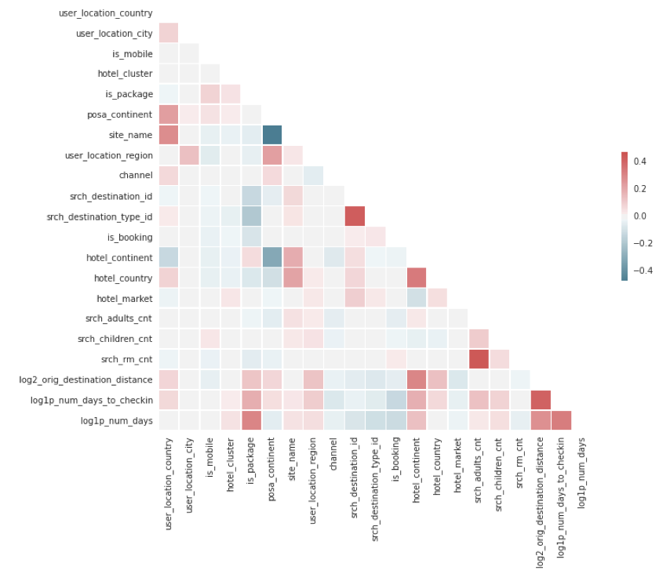
Hypothesis Testing

Slide 9
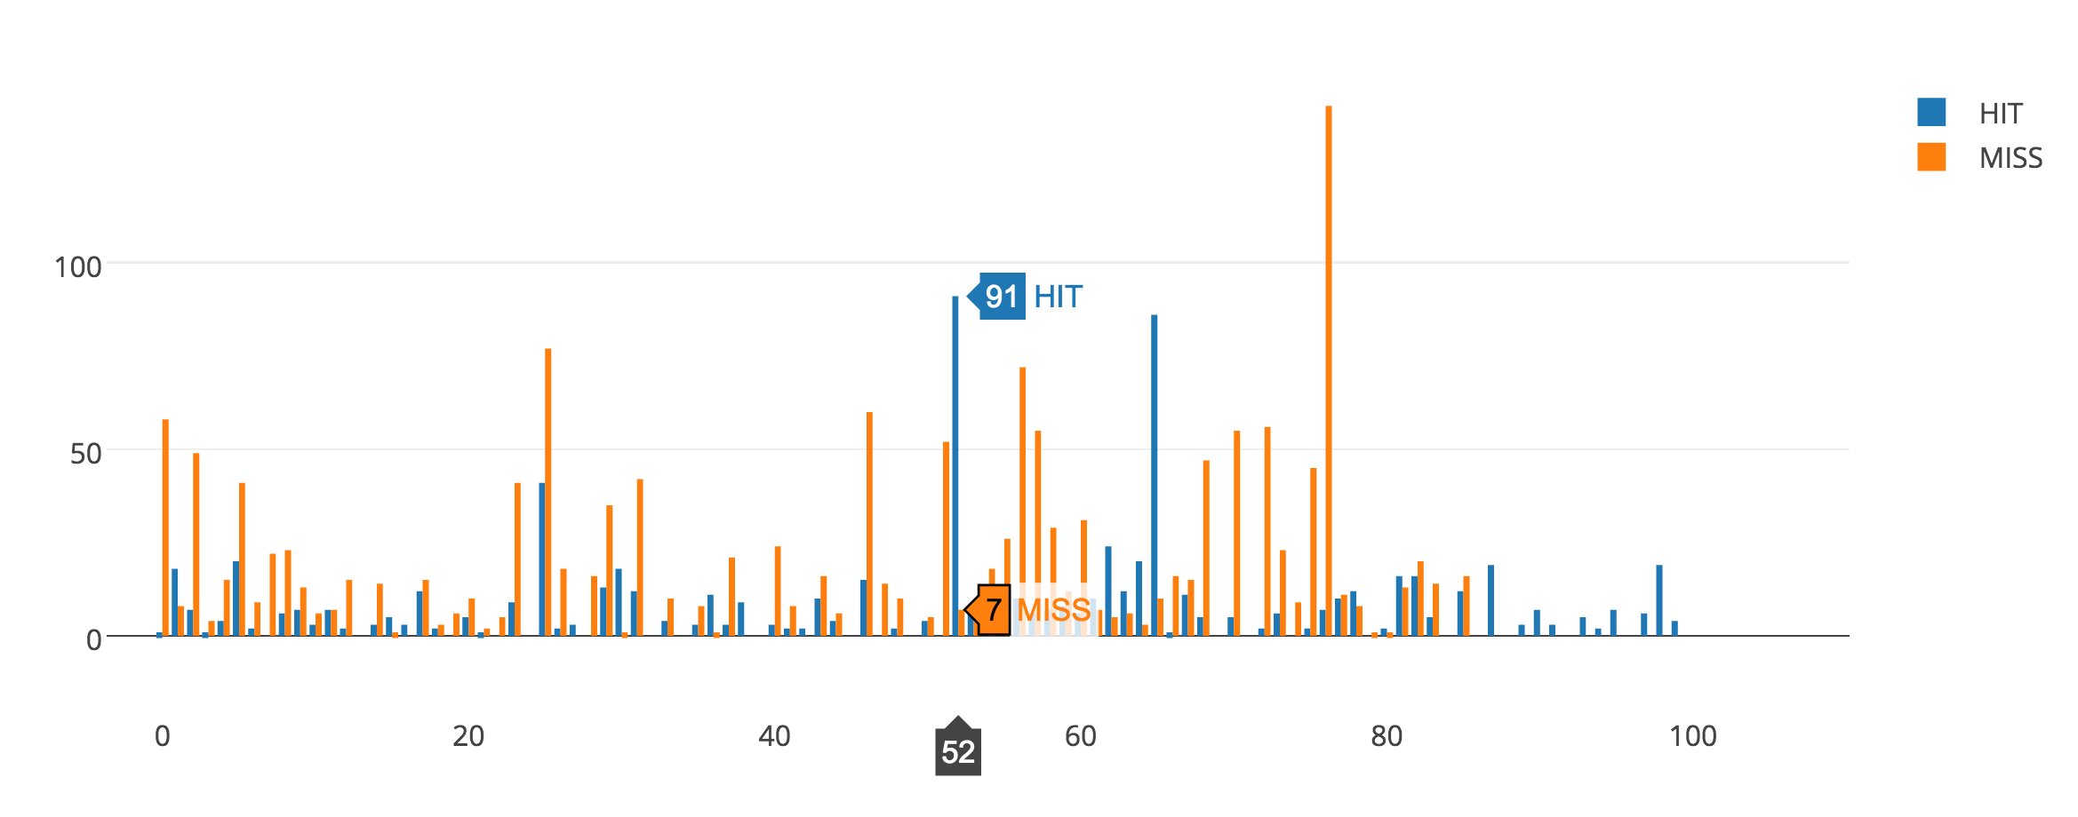
Validating results

Slide 10
Prediction Accuracy
Precision.
Calculated for the final results of recommendation system
Score achieved- 0.75

